Slide 1
Minds on: What is the acceleration of a ball being swung in a circle on the end of a string at a constant speed of 5.00 m/s if it takes 1.00s to complete each circle?
Acceleration in Uniform Circular Motion

Slide 2
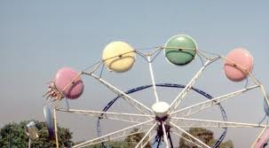
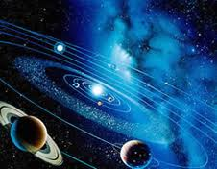
Uniform Circular Motion
Circular Coordinates

Slide 3
Uniform Circular motion occurs when an object moves in a circular path at a constant speed.
|v|=v
●
●
●
●

Slide 4
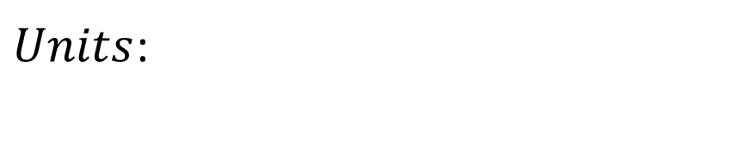
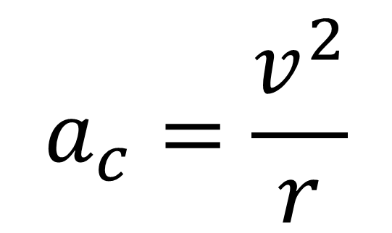
Instantaneous Acceleration Magnitude
●
$$a_{c}=\frac{v^{2}}{r}$$
●
●
$Units$:

Slide 5
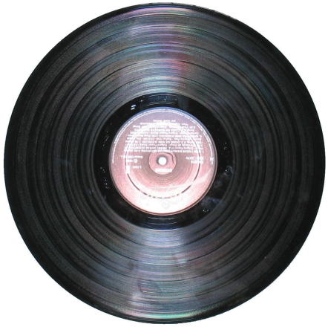
Applications:
Orbital motion
-planets about sun
-moon, satellites about Earth
Rotating Objects
-wheels, vinyl records
-amusement park rides (Windseeker!)
-spinning a bucket over your head
-washing machine, centrifuge

Slide 6
Example 1: A child on a merry go round is
3.0 m from the centre of the ride. If the child’s speed is 2.0 m/s, what is the magnitude of the child’s centripetal acceleration? (1.3 m/s² )

Slide 7
Other forms of the equation:
Given radius and period (T):
Circumference, C:
r
Period, T:
C
Speed :
We can rewrite the acceleration:

Slide 8
Given radius and frequency (f):
Frequency (f)- is the number of cycles that occur in one second. Frequency is the inverse of period.
Substituting this expression in for period:

Slide 9
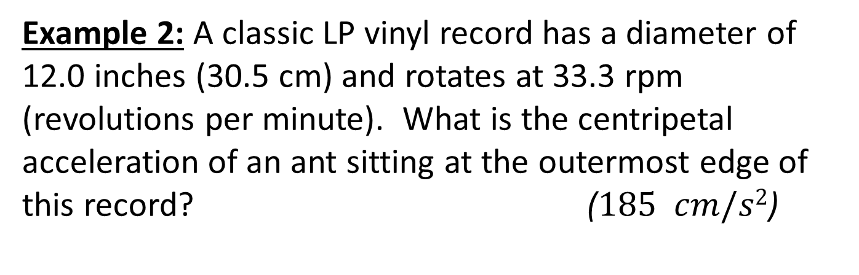
Example 2: A classic LP vinyl record has a diameter of 12.0 inches (30.5 cm) and rotates at 33.3 rpm (revolutions per minute). What is the centripetal acceleration of an ant sitting at the outermost edge of this record? ($185 cm/s2$)

